Slide 1
MODFLOW – Introduction
Organization & Main Packages
CE EN 547 – BRIGHAM YOUNG UNIVERSITY

Slide 2
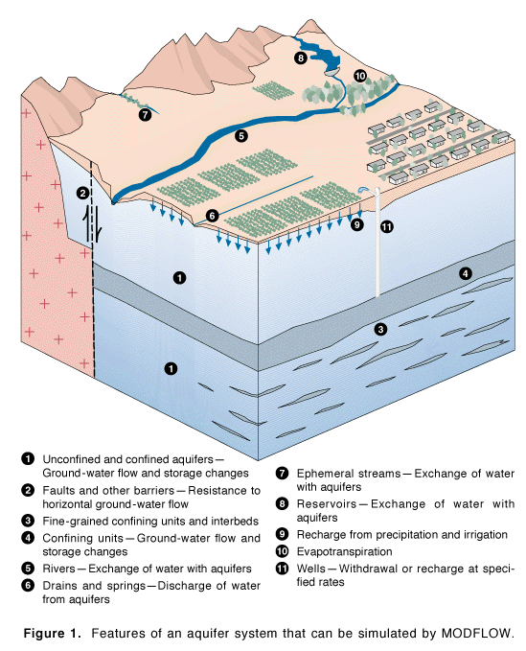
Developed by McDonald & Harbaugh of the USGS, 1983
Public Domain
Most widely used groundwater model
Steady state or transient saturated flow
Latest version is MODFLOW 2005
GMS uses MODFLOW 2000 version

Slide 3
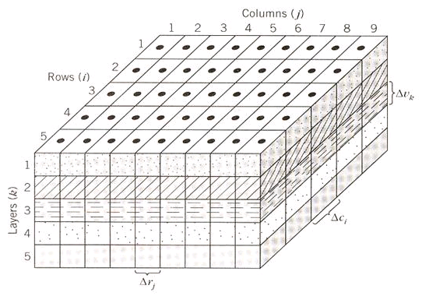
Finite Difference Model
3D Cartesian Grid
Cell-Centered

Slide 4
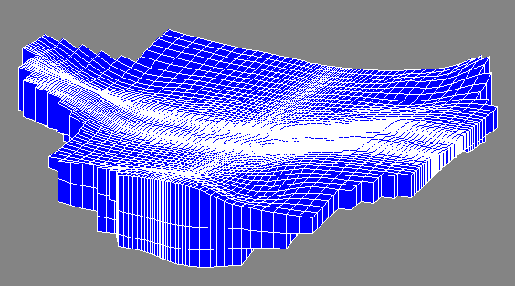
Grid Geometry
Orthogonal in xy
Thickness varies in z

Slide 5
Governing Equation
where:
K_{xx}, K_{yy}, K_{zz} = values of hyd. cond. along xyz axes
h = total head
W = Sources and sinks
S_{s} = Specific storage
t = time

Slide 6
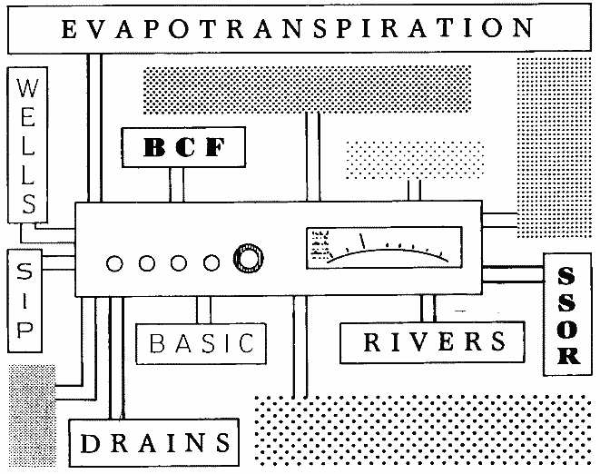
Processes & Packages
MODFLOW is divided into a series of processes & packages.
Major tasks are organized as processes
More specific tasks are performed by packages
Each process may use
one or more packages

Slide 7
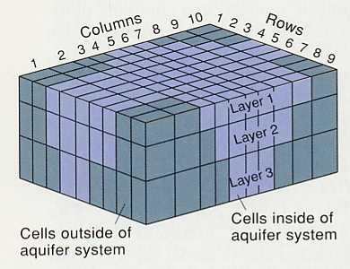
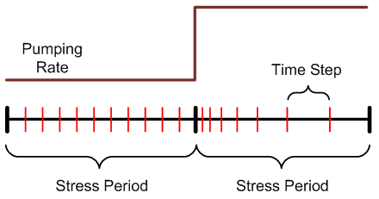
Global Process
Spatial discretization
  # rows, cols, layers
  Top/bottom elevations
Temporal discretization
  Stress periods
  Time steps
Units
Package Selection
Notes:
There is a layer discretization file and a global package file that are used by the Global Process.

Slide 8
Ground Water Flow Process
Formulation and solution of the ground water flow equation by the FD method
Main part of MODFLOW code
Includes
  Flow package (BCF, LPF, or HUF)
  Source/sink packages
  Solvers

Slide 9
Other Processes
Observation Process
  Observed heads and flows
  Used for calibration
SEN Process
  Sensitivity analysis
  Calibration
PES Process
  Automated parameter estimation (calibration)

Slide 10
Packages
Required Packages
  Basic
  Global
  Output Control
  Flow Package (BCF, LPF, HUF)
  Solver (SIP, SSOR, PCG, GMG, etc.)
List-Based Stress Packages
  River
  Stream-Aquifer Interaction
  Drain
  General Head
  Well
  Lake
  Changing Head Boundary
Array-Based Stress Packages
  Recharge
  Evapotranspiration
Other
  Horizontal Flow Barrier

Slide 11
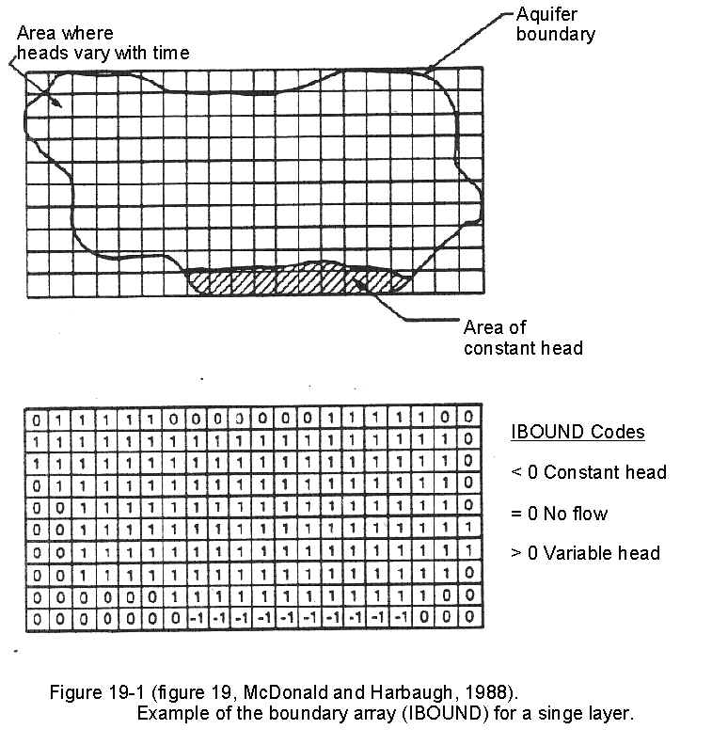
Basic Package
Starting Heads Array
  Provides initial set of heads for iterative solver.
  Defines head values at specified head cells
IBOUND Array
  Array of integers
  Three possible values
    zero = inactive
    negative = specified head
    positive = variable head
Notes:
http://va.water.usgs.gov/online_pubs/WRIR/98-4085/g-wfmcpasys_va.html

Slide 12
Active/Inactive Zones
Cells outside problem domain are marked as inactive

Slide 13
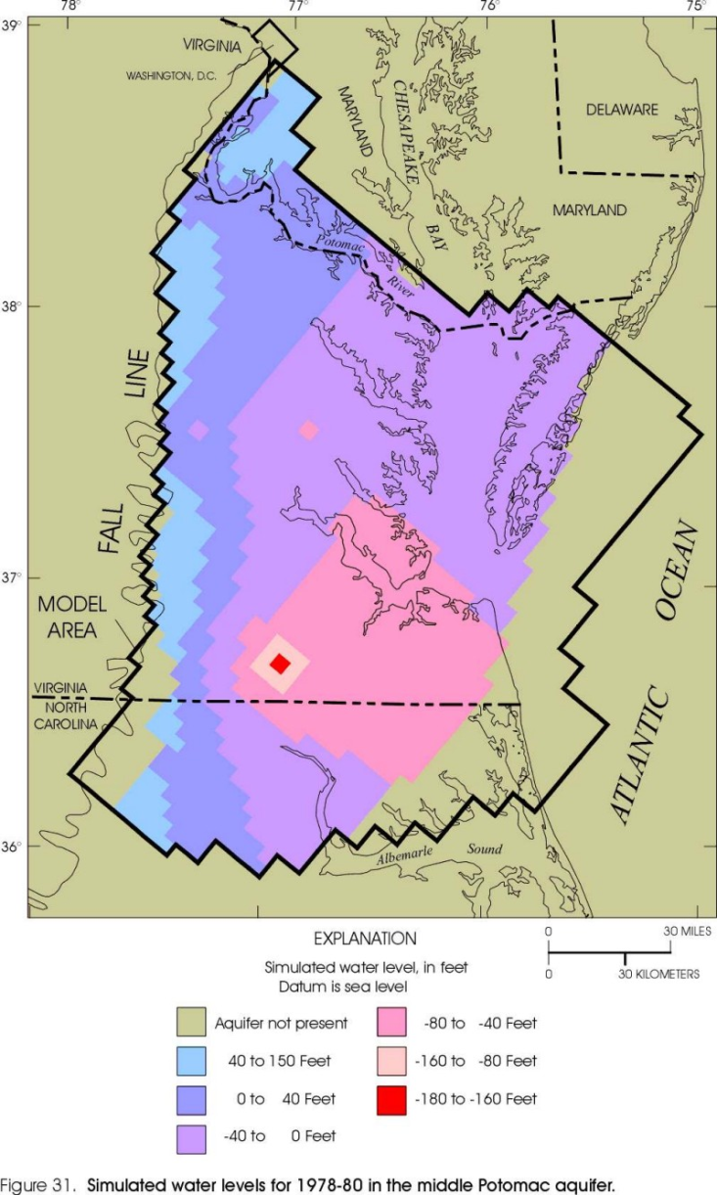
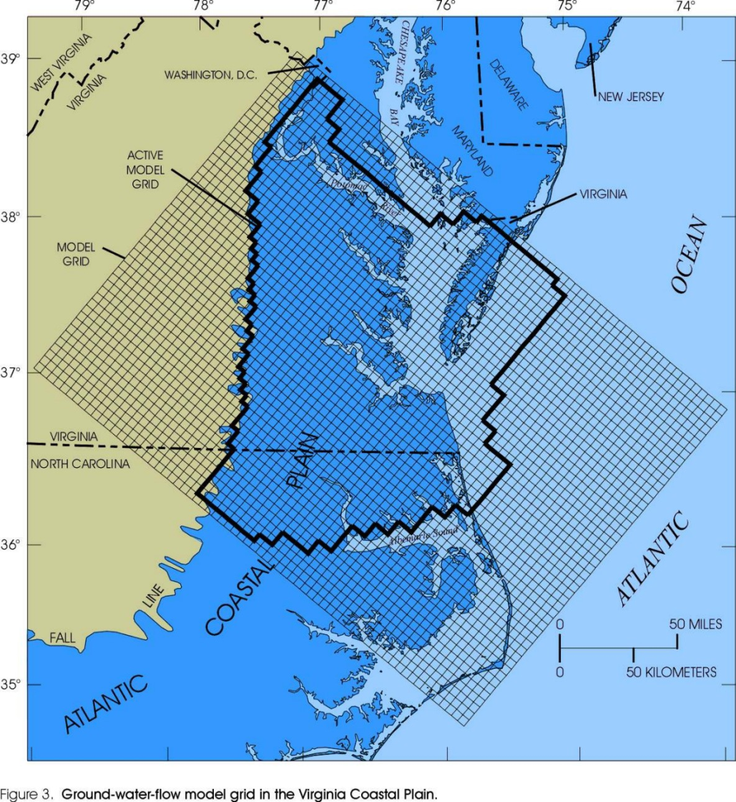
Virginia Coastal Plain Model
Notes:
http://va.water.usgs.gov/online_pubs/WRIR/98-4085/g-wfmcpasys_va.html

Slide 14
Flow Packages
Three options
  Block-Centered Flow (BCF)
  Layer Property Flow (LPF)
  Hydrogeologic Unit Flow (HUF)
One of the three packages must be used

Slide 15
BCF Package
Original flow package
Each layer is assigned a layer type
Layer data are entered (depending on type)
  Horizontal K
  Bottom elevation
  Transmissivity
  Leakance
  etc.

Slide 16
Layer Property Flow (LPF) Package
User enters K_{h}, K_{v} and storage terms for all layers, regardless of type
K_{v} can be entered as directly or in terms of vertical anisotropy
Horizontal anisotropy entered on a cell-by-cell basis
Two layer types
  Confined
  Convertible

Slide 17
LPF Property Input
Two options for inputting hydraulic properties:
  Array input
    one value per cell
  Material id approach
    Each cell is assigned a material id
    Properties are inherited from material

Slide 18
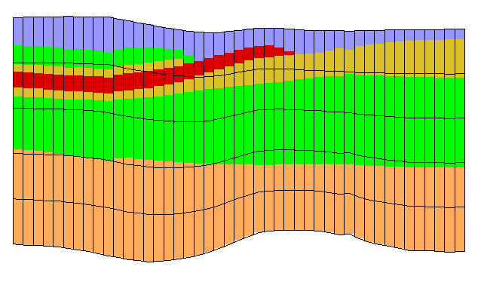
Hydrogeologic Unit Flow (HUF) Package
Aquifer stratigraphy represented in a grid-independent fashion
Equivalent K_{h}, K_{v} computed at runtime

Slide 19
HUF Arrays
Top
Thick 1
Thick 2
Thick 3
Thick 4
Notes:
HUF data defined by a top array and multiple thickness arrays. In some cases, most entries in the thickness arrays are zero.

Slide 20
Well Package
Assigned to individual cells
Q can be steady state or transient
Extraction well (neg Q)
Injection well (pos Q)

Slide 21
Drain Package
Assigned to individual cells
Used to simulate
  Agricultural drains
  Springs
  Creek beds
Required parameters
  Elevation
  Conductance

Slide 22
Drains
H_{ijk}
CD
Delev
When the head is above the drain elevation:
Q = CD (H_{ijk} - Delev) or
Q = CD (Delev - H_{ijk}) for proper sign on Q

Slide 23
Drains
CD
Delev
H_{ijk}
When the head is below the drain elevation:
Q = 0

Slide 24
Conductance
Darcy’s Law:
where
q = flow rate
k = hydraulic conductivity
Δh = head difference
L = flow length
A = gross cross-sectional area

Slide 25
Conductance, Cont.
Darcy’s law can be rewritten as:
where
The appropriate values for k, A, and L must be determined on a case-by-case basis

Slide 26
Recharge Package
One value assigned to each vertical column
Represents recharge due to precipitation
Can be steady state or transient
Infiltration rate must be assigned in correct units [L/T]

Slide 27
Factors Affecting Recharge Rate
Rainfall
Runoff
  Slope
  Soil type
  Land use
Evapotranspiration
  Soil type
  Vegetation

