Slide 1
MODFLOW – Part 2
Advanced Packages
CE EN 547 – BRIGHAM YOUNG UNIVERSITY

Slide 2
Advanced Packages
River
Stream-Aquifer Interaction
General Head
Changing Head Boundary
Horizontal Flow Barrier

Slide 3
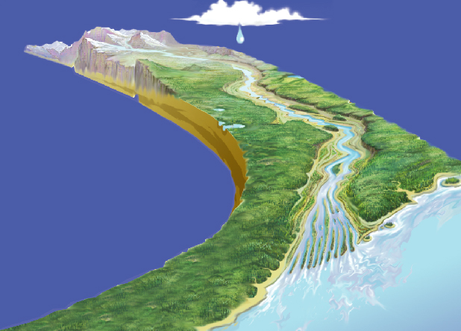
Stream-Aquifer Systems

Slide 4
River Package
Assigned to individual cells
If head is above river stage, flow is from aquifer to river
If head is below river stage, flow is from river to aquifer
Required parameters
  Conductance
  Bottom elevation
  Stage

Slide 5
Idealized Representation
H_{ijk} = Head in cell
HRIV = Stage in river
CRIV = Conductance of river bottom sediments
RBOT = Elevation of bottom of sediments
QRIV = Flow between aquifer and river

Slide 6
Case #1 - Head Above River Stage
QRIV = CRIV * (HRIV - H_{ijk})
(-Q signifies flow out of cell)

Slide 7
Case #2 - Head Below River Stage but Above River Bottom
QRIV = CRIV * (HRIV - H_{ijk})

Slide 8
Case #3 - Head Below River Bottom
QRIV = CRIV * (HRIV - RBOT)

Slide 9
River Conductance
Length of reach in each river cell is computed

Slide 10
River Conductance

Slide 11
Stream-Aquifer Interaction Package
Not part of original MODFLOW packages.
Like the River Package, water can flow from aquifer to stream or vice versa.
Unlike the River Package, stage is not specified. Rather, flow is routed using simple channel hydraulics and a stage is computed using Manning’s equation.

Slide 12
Segments and Reaches

Slide 13
Attributes
Segments
  Incoming flow (for top segments and diversions)
  Width
  Slope
  Manning’s roughness coefficient
Reaches
  Conductance
  Elevation of the bottom of the streambed
  Elevation of the top of the streambed

Slide 14
General Head Package
Assigned to individual cells
Often used to simulate lakes, reservoirs
Required parameters
  Head
  Conductance

Slide 15
General Head
Q = Cgh * (H_{source} - H_{ijk})

Slide 16
General Head Boundary
Gaining Lake/Reservoir
Losing
Lake/Reservoir

Slide 17
Lakes and Reservoirs

Slide 18
CHD Package
CHD = Changing Head
Original method for defining specified heads works for static (steady state) heads only.
  IBOUND
  Starting Heads Array
CHD later added to allow for transient specified head boundary conditions
Assigned to individual cells
Can be used for steady-state case also

Slide 19
Horizontal Flow Barrier Package
Not part of original MODFLOW packages
Used to simulate low permeability barriers such as sheet pile walls or slurry trenches.
Assigned to cell boundaries (pairs of cells)
Each instance is assigned a hydraulic characteristic = K/thickness

Slide 20
HFB Cell Boundaries

Slide 21
HFB

